Slide 1
Federal Income Taxation Residual Income
Prof. Colon
Spring 2025

Slide 2
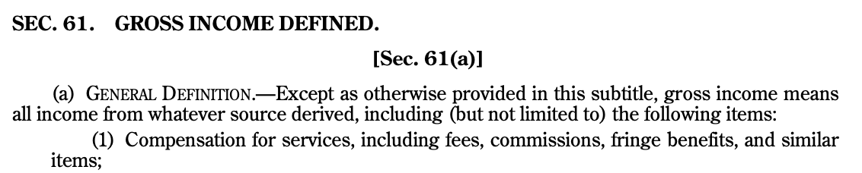
Section 61(a)(1)

Slide 3
Historical Antecedents of Income
Trust
Capital or Corpus: Assets of the trust that produce income, either contributed by settlor or purchased by proceeds of sale of capital
Income: Periodic Return from Capital, such as dividends, rents, interest

Slide 4
Eisner v. Macomber, 252 U.S. 189 (1920)
Income is defined as the gain derived from capital, from labor, or from both combines, provided it to be understood to include profit gained through a sale or conversion of capital assets.

Slide 5
CIR v. Glenshaw Glass (34 U.S. 426, reh’g denied, 349 U.S. 925 (1955))
Glenshaw Glass
Hartford-Empire Co.
In anti-trust litigation, Hartford paid Glenshaw Glass a total payment of 800K, of which 325K represented payment for fraud & punitive damages.
Here we have instances of undeniable accessions to wealth, clearly realized, and over which the taxpayers have complete dominion.

Slide 6


Rev. Rul. 76-131
Monthly stipend ($) paid to lower-income Alaskan residents 65 or older

Slide 7
Notice 99-3
(1) The only payments received by the individual with respect to the work activity are received directly from the state or local welfare agency (for this purpose, an entity with which a state or local welfare agency contracts to administer the state TANF program on behalf of the state will be treated as the state or local welfare agency);
(2) The determination of the individual’s eligibility to receive any payment is based on need and the only payments received by the individual with respect to the work activity are funded entirely under a TANF program (including any payments with respect to qualified state expenditures…; and
(3) The size of the individual’s payment is determined by the applicable welfare law, and the number of hours the individual may engage in the work activity is limited by the size of the individual’s payment (as determined by applicable welfare law) divided by the higher of the federal or state minimum wage.

Slide 8
In-kind Consumption
(d) Compensation paid other than in cash.—(1) …if services are paid for in property, the fair market value of the property taken in payment must be included in income as compensation. Reg. §1.61-2(d)(1)
Is all in-kind consumption an accession to wealth and therefore taxable under the residual clause of §61 (and not otherwise exempted by a specific code section, e.g., gifts, prize?
Oscar gift bag?
Receipt of medical care under Medicare?
Lunch paid for by your lawyer?

Slide 9



United States v. Gotcher, 401 F.2d 118 (5th Cir. 1968)
10-day expense paid trip to Gotchers to visit VW manufacturing facilities to encourage investment in US VW dealerships.

Slide 10
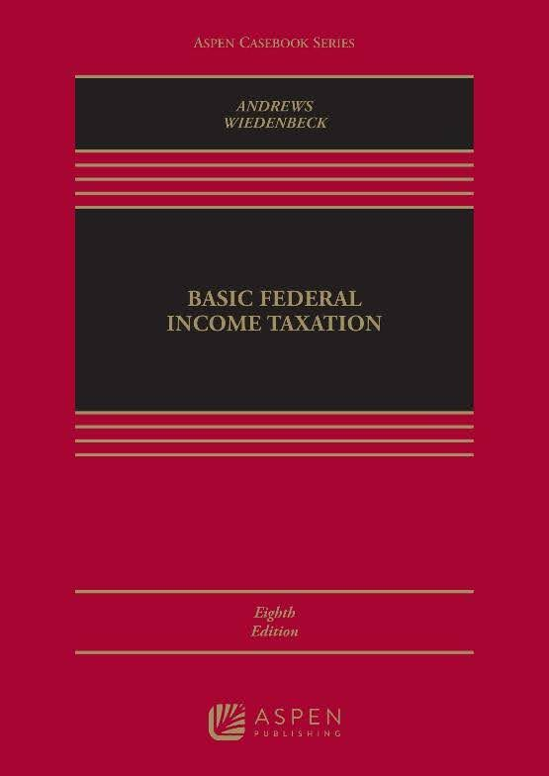


Haverly v. US, 513 F.2d 224 (7th Cir. 1975)
Check out our tax great book
Thanks, but I think that I’ll donate it to the library and take a charitable deduction

Slide 11



Rev. Rul. 76-96
$$$$$
Buys a car at arm’s length price
Car
Manufacturer rebates to purchasers

Slide 12



Helvering v. Bruun, 309 U.S. 461 (1940)
Owner leases building in 1915. In 1929, Tennant demolished building pursuant to lease and constructs a new building. In 1933, lease cancelled for rent default. New building had FMV of 64K in 1933, and the unamortized cost of old building was 13K. CIR argues that owner had GI of 51K in year of repossession.

Slide 13

Treasure Trove
Illegal gains constitute gross income. Treasure trove, to the extent of its value in United States currency, constitutes gross income for the taxable year in which it is reduced to undisputed possession. Reg. §1.61-14

Slide 14
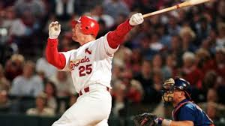
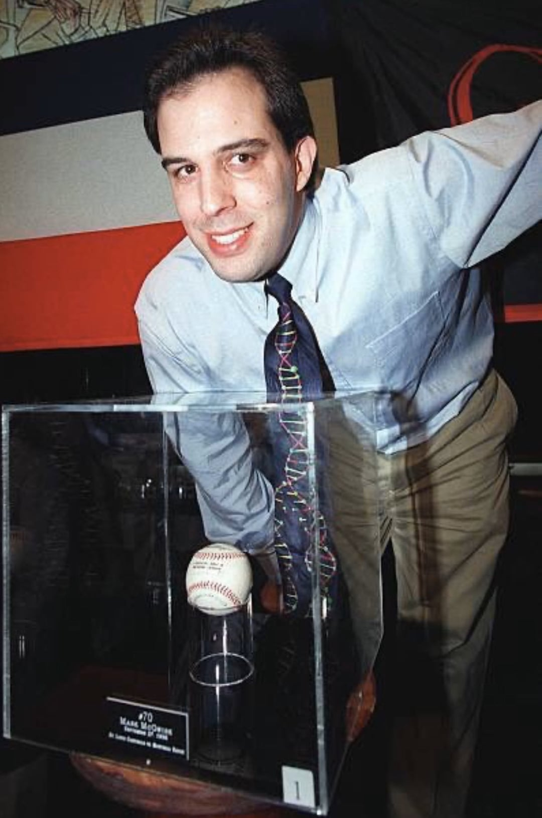
Are caught baseballs income?
McGwire hits 70 HRs in 1998. Phil Ozersky catches the ball of the 70th HR. He latter sells it for $3MM. Should it be income at the time he caught it?
Todd McFarlane, a well-known comic book artist, bought the 70th home run ball at an auction for about $3 million right after the 1998 season. But since McGwire was put through the wringer of the sport’s steroids scandal plus Barry Bonds breaking his mark, the ball’s value has significantly decreased to around $300K.

